Slide 1
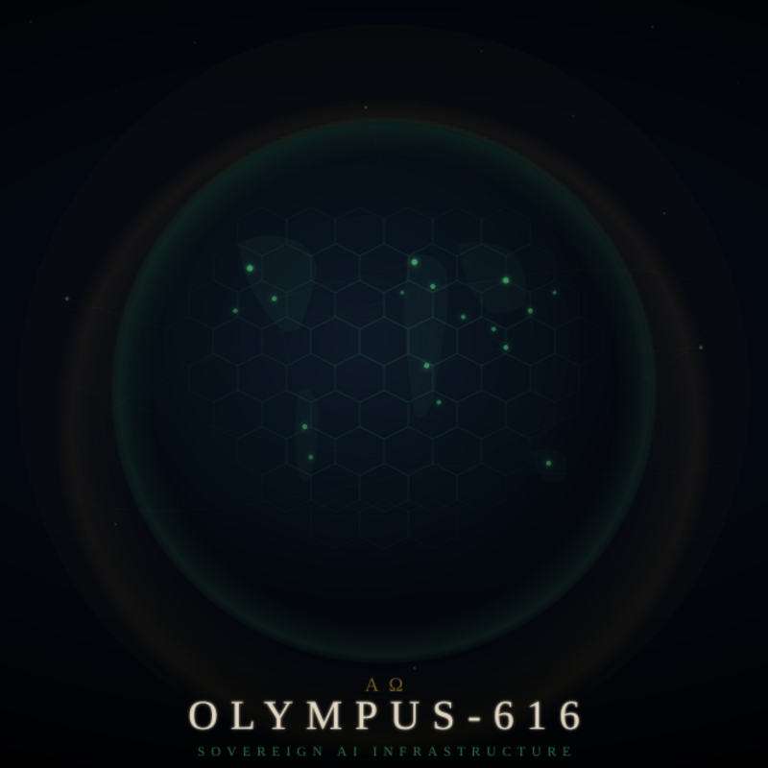
OLYMPUS-GRID
Sovereign AI Infrastructure
Series 1 Redeemable Preferred Units — $2,000,000
CONFIDENTIAL — March 2026

Slide 2
THE PROBLEM
AI requires surrender
Data Leaves Your Control
Every major AI platform requires sending your data to external servers. For regulated industries, this creates unacceptable compliance risk.
Vendor Lock-In
Once you build on OpenAI or Google, switching costs are enormous. Your AI strategy becomes hostage to someone else’s pricing and policy decisions.
No Sovereignty
You can’t choose your model, your deployment, or your terms. The platform decides what you can do with your own intelligence.

Slide 3
THE SOLUTION
Your hardware. Your models. Your data. Your grid.
Deploy Anywhere
Choose Your AI
Identical deployment on laptop, private cloud, or AWS. Zero code changes. Your infrastructure, your rules.
Run any model — local (Ollama), cloud (Anthropic, OpenAI, Bedrock), or custom. Switch providers without rewriting anything.
Connect Securely
Own Everything
OAuth-authorized connections to Salesforce, Google, HubSpot. Your AI accesses your enterprise data with your permission, revocable at any time.
Every byte of data stays under your control. Export everything, always. No vendor can hold your intelligence hostage.

Slide 4
WHAT EXISTS TODAY
4 years of development. Working technology.
31
4
0
1
Services Online
Years Built
Code Changes
iPhone App
Complete service mesh with health monitoring and self-healing
Solo-engineered by a Salesforce CTA
Deploy local → cloud with identical codebase
TurtleShell.ai — ready for App Store
Demonstrated: iPhone → Service Mesh → Salesforce OAuth → AI Response → Streaming to Device

Slide 5
THE FOUNDER
Salesforce CTA
Certified Technical Architect — highest Salesforce certification. Fewer than 500 globally.
Prior Exit
Co-founded a Salesforce ISV that was successfully acquired by a marketing automation firm.
Enterprise Architect
Decade of architecture for healthcare, life sciences, and financial services in regulated environments.
Solo Builder
Designed and deployed 31-service platform, iOS app, and enterprise integrations as a single engineer over 4 years.

Slide 6
REVENUE MODEL
CONSUMER
ENTERPRISE
TurtleShell.ai
Olympus Grid
Free — Download, explore, connect
Pro $19.99/mo — Cloud AI, advanced features
Sovereign $49.99/mo — Local AI, full data sovereignty
Starter $500/mo — Small teams, basic MCP
Professional $2,500/mo — Mid-market, full integration
Custom $7,500/mo — Dedicated deploy + SLA
Y3 Target: 6,860 paid users
Y3 Target: 55 enterprise clients

Slide 7
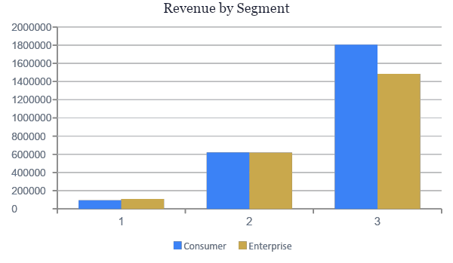
FINANCIAL PROJECTIONS
$4.73M
3-Year Total Revenue
$4.49M
M36 Annualized Run Rate
$3.26M
M36 Cash Position
$331K
3-Year Tithe to Foundation

Slide 8
INVESTMENT STRUCTURE
Series 1 Redeemable Preferred Units
INVESTMENT
VALUATION
RETURN
$2,000,000
$20M Pre-Money
8% + Premium
Series 1 Redeemable Preferred Units
10% economic interest, 0% voting
Cumulative preferred + 10–20% premium
TIMELINE
GOVERNANCE
MAX PAYOUT
36 Months
Zero
$2,880,000
Mandatory redemption — interest terminates
No votes, no board, no consent rights
44% total return at Month 36
Note: Tithe Covenant (7%) is senior to all distributions including preferred returns.
Issuer: CloudPremise LLC (CO) → Delaware C-Corp within 90 days. Units convert to Class C (Non-Voting) automatically.

Slide 9
INVESTOR RETURNS
Timing | Pref Return | Premium | Total Payout | Total Return
Month 12 | $160,000 | $200,000 (10%) | $2,360,000 | 18%
Month 24 | $320,000 | $300,000 (15%) | $2,620,000 | 31%
Month 36 | $480,000 | $400,000 (20%) | $2,880,000 | 44%
vs. Alternative Investments
S&P 500
~10%/yr
Real Estate
~10%/yr
Private Credit
~12%/yr
This Investment
~15%/yr

Slide 10
THE TITHE
7¢ of every dollar. Forever.
7% of recognized gross revenue flows to the Olympus Foundation — irrevocable, encoded in the charter, non-negotiable.
$1M revenue
→
$70K
to the Foundation
$10M revenue
→
$700K
to the Foundation
$100M revenue
→
$7M
annually, in perpetuity
Your capital doesn’t just generate returns. It generates impact.
Priority: Tithe is senior to all other distributions, including investor preferred returns.

Slide 11
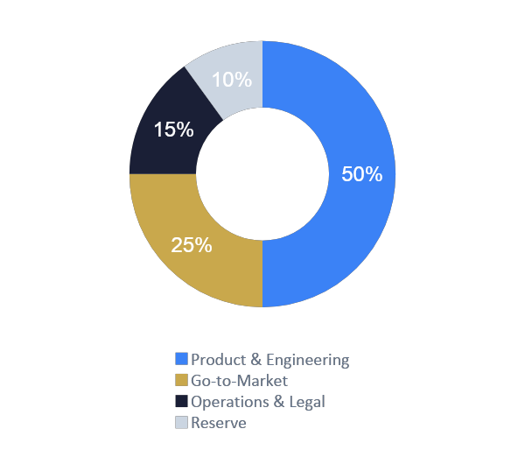
USE OF FUNDS
~50%
Product & Engineering
3 hires over 14 months. Platform hardening, App Store launch, integration expansion.
~25%
Go-to-Market
Enterprise sales, AppExchange, paid acquisition ramp in Year 2.
~15%
Operations & Legal
C-Corp formation, securities counsel, compliance.
~10%
Reserve
Working capital buffer for a 36-month timeline.

Slide 12
WHY THIS INVESTMENT
Technology Exists
4 years built. 31 services. Working end-to-end demos. This is not a concept.
Market Is Ready
Enterprise AI adoption meets regulatory demand for sovereignty. Perfect timing.
Founder Is Credible
CTA, prior exit, decade of regulated enterprise architecture.
Structure Protects You
Fixed returns, mandatory redemption, liquidation preference. No surprises.
Impact Is Real
7% of gross revenue, forever, to eliminate human suffering.

Slide 13
The grid is sovereign.
The tithe is eternal.
The work begins.
CloudPremise LLC | cloudpremise.com
CONFIDENTIAL

